Slide 1

DriverPass System Analysis
Dylan Dunagan
CS-255
22 June 2025
Notes:
[No speaker notes required for this slide.]

Slide 2

System Requirements
Functional Requirements:
The system will be a cloud-based system requiring internet connections.
The system must be able to schedule, cancel, and modify all appointments and be able to log results
Non-Functional Requirements:
The system must be compatible with local DMV’s to stay compliant with local laws and regulations.
The system should have role-based access to control the different levels of permissions.
Notes:
Driverpass plans to be an online system allowing users to access it from any internet capable device, anywhere, and anytime. To provide this online access, DriverPass will need to utilize a cloud-based system, not only to ease the passage of information, but to also incorporate the cloud’s built-in security and backup technology. Driverpass will not have to worry about the security and maintenance of the cloud servers. The system will be able to handle a full online learning environment including online lessons, practices tests, and a full scheduling system allowing for reserving, modifying, and cancelling appointments with in-person driving instructors. Each user type, whether it is a staff member or student will have their own specific permissions that change how the system and program works for them and changes what each person will have access to. To stay compliant with local laws and regulations, the system will receive updates from the DMV so that students are receiving the most up-to-date education.

Slide 3
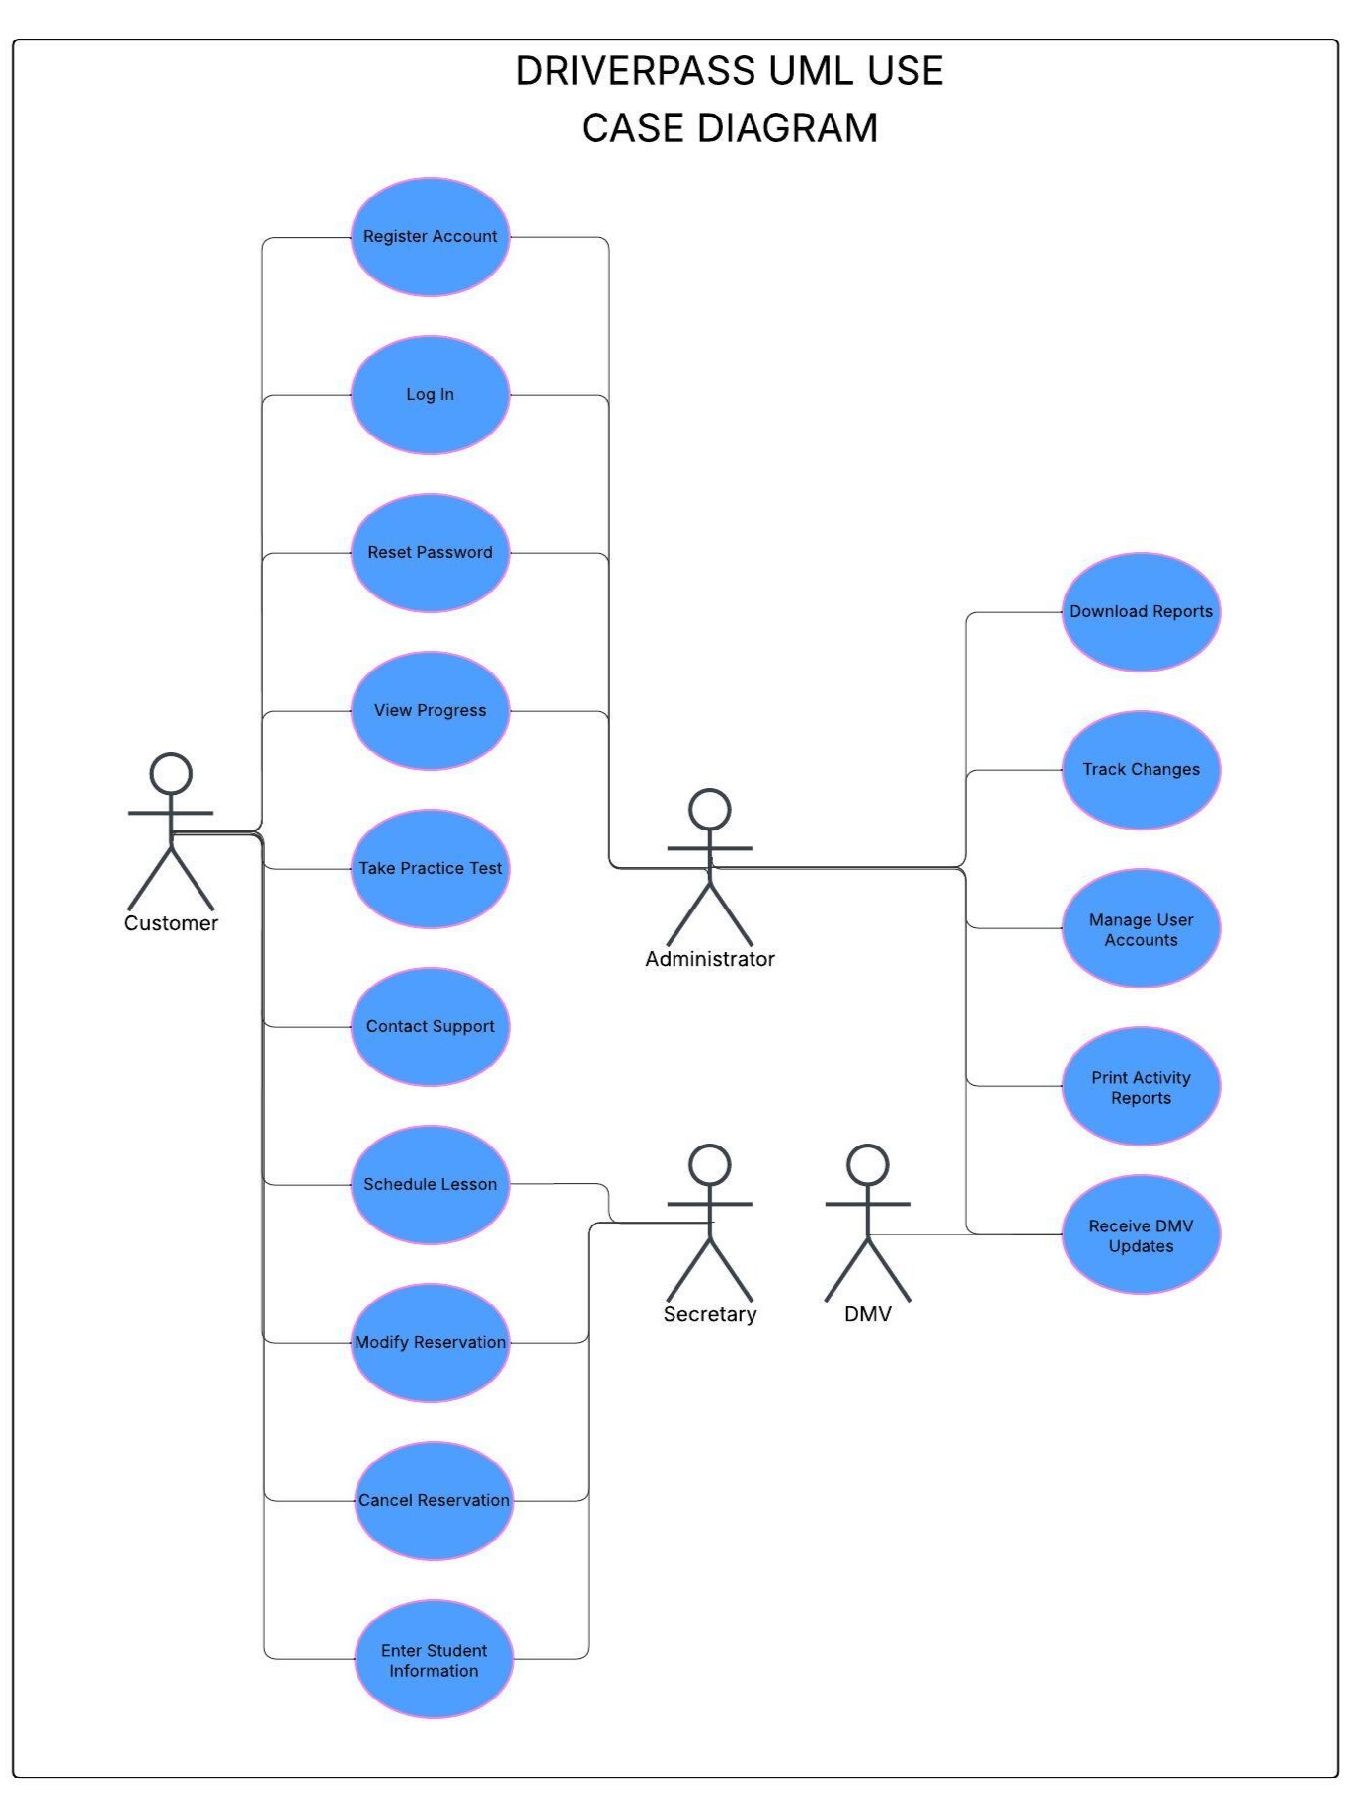
Use Case Diagram
Notes:
This diagram shows the main users of the DriverPass system. Many of the users will have the same functionality that change depending on the specific user’s permissions. The customer will have the ability to register their account and log in through a secure system, reset their passwords if needed, schedule their in-person driving lessons, modify their reservations if needed, take practice tests, and view all their progress through the system. The administrator will also be able to log into the system, reset their passwords if needed, but most importantly, they will be able to view the student’s progress and print the reports of that progress. They will also have different functions from the student, such as, manage the various user accounts, receive the updates from the DMV, and track changes to the system. The secretary will have access to the scheduling system allowing them to enter student information and schedule lessons as the student requests. The DMV will only need to send over applicable updates to the system so that all learning materials can stay current.

Slide 4
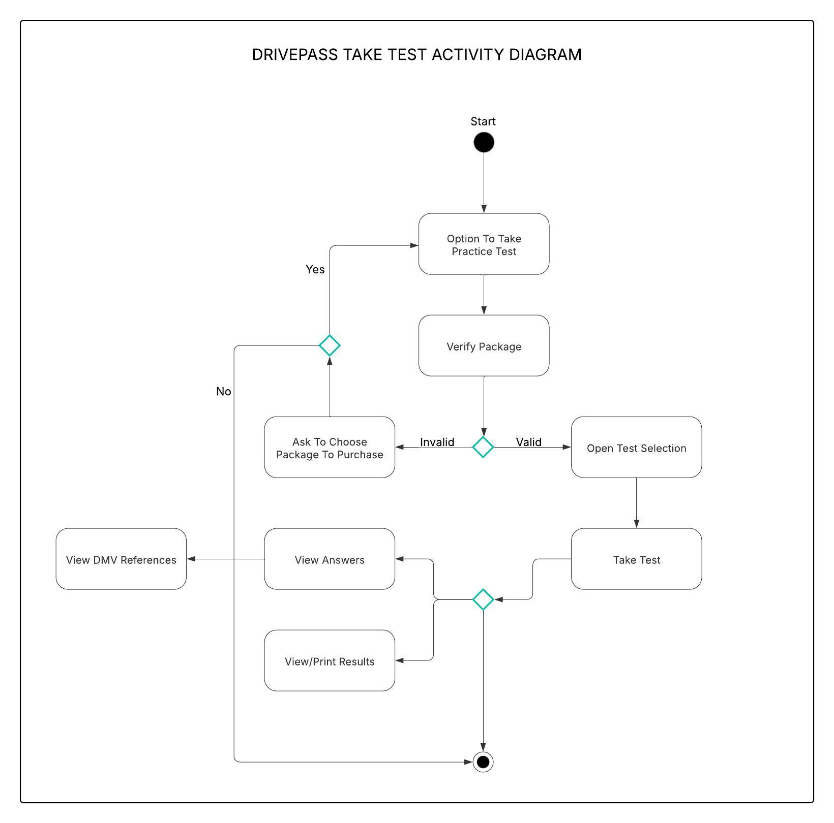
Activity Diagram
Notes:
This diagram shows the step-by-step process of how a student will take one of the many online practice tests. This will take place after the student has logged in through the secure, two-factor authentication system. The student will have the option to take a practice test. This will then lead the system to verify which learning package they are subscribed to. If the student does not currently have a learning package, the system will take them to the “Package Purchase” page. If the student does have a learning package, they will be given the option to select which practice test they want to take. The system should have numerous tests ranging from difficulty and content, giving the student the ability to test on aspects that they might be struggling with. After they have selected their test, they will then take the test, and the system will log their results. Now the student will have the option of viewing and printing their results or viewing the answers to the questions that they got incorrect. When viewing the answers, the system should have a link to the reference material that coincides with the specific question.

Slide 5
Security
Role-based access
Two-Factor Authentication
Password reset functionality
Secure payment processing
Activity tracking
Notes:
Security is built into the system itself not only with the unique log-in credentials, but with two-factor authentication. Each user will log in using their username and password, the system will then offer an email or a text message to allow for a secondary way to authenticate the user’s identification. After the secondary source has been verified, the users will have their own specific roles within the system. This puts security into the core of the system. If the user can’t remember their password, they will have the option to reset it by also utilizing the secondary authentication method. This will ensure that the correct person is receiving the link to reset the password, and it also will notify a user if the wrong person is trying to access their account. All users will want their payment information as secure as possible, so not only will DriverPass utilize an ordinary credit card process, but they should also utilize other payment methods such as PayPal, CashApp, Apple Pay, and many others. Lastly, the system should log when people log into their accounts and time-stamp it so that if there is a security breach of any kind, IT and administrators will be able to look into who was online and when.

Slide 6
System Limitations
Offline access is limited
Changing the packages customers can choose will require more work
DMV must be compatible
The budget is not defined
Notes:
There are a few limitations to keep in mind. Since DriverPass is an online system, access to the offline version becomes very limited. Without online access, users can only view reports, but they will not be able to edit data or reservations at all. As of right now, administrators can only turn learning packages on and off, they are not able to create or delete learning packages. This will take the work of a developer to add or remove the learning packages that are currently available. For DriverPass to work as efficiently as possible, the local DMV’s must be able and willing to send updates to DriverPass. Without their input and updates, the learning materials and practice tests would surely become outdated over time. Lastly, the budget for the DriverPass project has not yet been defined. This directly correlates to how the amount of work, time, and attention that can be placed into building this program. After a budget has been agreed upon, DriverPass should look into ensuring that the DriverPass system is modular enough to keep prices down as changes are made in the future.

